Slide 1
Describing the CMM and the CMMI
Objective:
Examine the SEI’s Capability Maturity Model for Software
Compare it to the Capability Maturity Model - Integrated
Notes:
Animation: title zooms in automatically
Show copy of the CMM and CMMI documents
There is a really good summary article on CMM by Mark Paulk that first appeared in IEEE magazine, and included in SME Guidebook. I highly recommend it for anyone that needs a quick and good understanding of the model.
The CMM has a sunset date of Dec 2003. We will be seamlessly transitioning the the CMMI, which will eventually combine the SW, SE, IPD, and SA CMMs.
Icebreaker – What questions would you like answered about CMM/CMMI? Write them up on the board and review them with class just before you close.

Slide 2
The CMM:
Capability Maturity Model for Software - Overview
Focuses on practices that are under control of the software group
Describes common sense, efficient, proven ways of doing business (which you should already be doing) - not a radical new approach
Presents a minimum set of recommended practices that have been shown to enhance a software development and maintenance capability
  It defines the expectation (the “what”)
  Without overly constraining the implementation (the “how”)
Used by Government and industry around the world to measure maturity of software development organizations
Developed at the DoD-sponsored Software Engineering Institute (SEI)
  Drafted in 1990; Version 1.1 dated 1993, to be retired in December 2003
  Being replaced by the SEI’s CMM Integration (CMMI)
Notes:
CMM is a model that describes how software engineering practices in an organization evolve
- work performed is organized and viewed as a process
- the evolution of the process is manages separately
Like all models, CMM is abstract, but based on experience.
Is DESCRIPTIVE, not PRESCRIPTIVE.
“All models are wrong, some models are useful.” - Box’s Rule, George Box (quoted in CrossTalk Jan 97) CMM is not a silver bullet.
The CMM is a large living document (561 pages - show it) - Available on SEI website or from SEPO (see references)
No specific tools, methods, or technologies are mandated. No application domains, software technologies, people management

Slide 3

What is this CMMI?
C M M I
What it is: A process improvement model that provides a set of industry-recognized practices to address productivity, performance, costs and stakeholder satisfaction in the systems engineering and software development process.
How it is different: The CMMI provides an integrated, consistent, enduring framework for enterprise-wide process improvement and can accommodate new initiatives as future needs are identified.
Unlike single-discipline or stove-pipe models that can result in confusion and higher costs when implemented together.
Who it is for: Those providing systems and software engineering products and services to organizations who transform customer needs expectations, and constraints into products, and supporting these products throughout their life.
Notes:
ISO-9000/2000
Earned value method
MS Project
ERP
Risk Radar

Slide 4
Capability Maturity Model Integrated - Overview
Multiple models, based on disciplines addressed
  CMMI - SW: Software Engineering
  CMMI - SE / SW: above plus Systems Engineering
  CMMI - SE / SW / IPPD: above plus Integrated Product & Process Development
  CMMI - SE / SW / IPPD / SS: above plus Supplier Sourcing
Two representations
  Staged: focus is on a Maturity Level by mastering sets of Process Areas
  that are grouped into 5 Maturity Levels (like SW-CMM)
  Continuous: focus is on selected portions of Process Areas to achieve
  a Process Capability Level
Developed at the DoD-sponsored Software Engineering Institute (SEI)
  Drafted in 1998; current versions dated 2002
  Models and information at http://www.sei.cmu.edu/cmmi/
C M M I
Notes:
CMMI is a model that describes how engineering practices in an organization evolve
- work performed is organized and viewed as a process
- the evolution of the process is manages separately
Like all models, CMMI is abstract, but based on experience.
Is DESCRIPTIVE, not PRESCRIPTIVE.
“All models are wrong, some models are useful.” - Box’s Rule, George Box (quoted in CrossTalk Jan 97) CMM is not a silver bullet.
The CMMI is a large living document ( show it) - Available on SEI website or from SEPO (see references)
No specific tools, methods, or technologies are mandated. No application domains, software technologies, people management
SSC will be using Staged version of CMMI - SE / SW / IPPD / SS

Slide 5



The Three Elements of Project Success
Process: a defined method involving steps or operations
People:
Skills, Training,
Management
Technology:
Application domains,
tools, languages,
information, environments
Improved Process + Competent Workforce + Appropriate Technology
=
Reduced Risk, Higher Productivity, and Better Quality
Notes:
This from the SEI: All 3 elements important, People most important.
A fool with a tool is still a fool, unless he has a rule!
KEEP SHORT!
Ask class to define PROJECT SUCCESS (on schedule, within budget, meeting customer’s requirements, keeping employees satisfied, growing business)
A team of experts with cutting edge tools still need a PROCESS or they are fools with tools.
-----------
Focus on PEOPLE? No, people on average are as ‘good” as they are trained to be. Working harder is not the answer. Working smarter (through process) is the answer.
Focus on TECHNOLOGY? No, too often applied without suitable roadmap. Will not pay off. Must be applied to appropriate process roadmap.
Should focus on PROCESS – quality of product depends on quality of process. Worldwide movements on quality processes (i.e., ISO)

Slide 6
SEI Capability Maturity Model CMM
Result
Level
Characteristic
Key Process Areas
Productivity
& Quality
Optimizing Continuous process Process change management
(5) capability improvement Technology change management
Defect prevention
Managed
(4)
Defined Software process defined
(3) and institutionalized to
provide product quality
control
Repeatable
(2)
Initial
(1)
Product quality planning; Software quality management
tracking of measured Quantitative process management
software process
Peer reviews
Intergroup coordination
Software product engineering
Integrated software management
Training program
Organization process definition
Organization process focus
Management oversight
and tracking project;
stable planning and
product baselines
Software configuration management
Software quality assurance
Software subcontract management
Software project tracking & oversight
Software project planning
Requirements management
Ad hoc
(success depends
on heroes)
"People"
Risk
Notes:
Levels 2 through 5 are decomposed into KPAs: cluster of related activities that achieve goals for enhancing process capability.
CMM describes what to do, not how to do it. Has common sense, efficient, proven ways of keeping whole team going in same direction. This is what you (prog. Mgr) are probably already doing because you learned you had to.
CMM is not a radical new approach - it is what you should be doing anyway!
Focus on 5 levels, 18 KPAs

Slide 7
CMMI SE/SW/IPPD/SS Staged Representation
C M M I
Level Focus Process Areas
Quality
Productivity
Continuous
Process
Improvement
Organizational Innovation and Deployment
Causal Analysis and Resolution
5 Optimizing
4 Quantitatively
Managed
Quantitative
Management
Organizational Process Performance
Quantitative Project Management
Requirements Development
Technical Solution
Product Integration
Verification
Validation
Organizational Process Focus
Organizational Process Definition
Organizational Training
Integrated Project Mgmt (with IPPD extras)
Risk Management
Decision Analysis and Resolution
Integrated Teaming (IPPD only)
Org. Environment for Integration (IPPD only)
Integrated Supplier Management (SS only)
3 Defined
Process
Standardization
Requirements Management
Project Planning
Project Monitoring and Control
Supplier Agreement Management
Measurement and Analysis
Process and Product Quality Assurance
Configuration Management
Basic
Project
Management
2 Managed
Risk
Rework
1 Initial
Notes:
22 PA in SE/SW
25 PAs in SE / SW / IPPD / SS

Slide 8
Migrating from SW-CMM to the CMMI
SW-CMM Key Process Areas CMMI Process Areas (SE/SW)
Defect prevention Causal analysis and resolution
Technology change mgmt Org. innovation & deployment
Process change mgmt
Quantitative process mgmt Org. process performance
Software quality mgmt Quantitative project mgmt
Org. process focus Org. process focus
Org. process definition Org. process definition
Training program Organizational training
Integrated software mgmt Integrated project mgmt
Risk Management
Software product engr Technical solution
Product Integration
Intergroup coordination Verification
Peer reviews Validation
Requirements Development
Decision Analysis / Resolution
Requirements management Requirements management
Software project planning Project planning
SW project track & oversight Project Monitoring & Control
Measurement and Analysis
Software subcontract mgmt Supplier agreement mgmt
Software quality assurance Product & Process QA
Software configuration mgmt Configuration mgmt
LEVEL 5
OPTIMIZING
Focus still on continuous improvement
LEVEL 4
MANAGED
Focus still on quantitative management
LEVEL 3
DEFINED
Focus still on process standardization
LEVEL 2
REPEAT-
ABLE
Focus still on basic project management

Slide 9

Level 1: the “Initial” Level
Success depends on heroes
Good performance is possible - but
Requirements often misunderstood, uncontrolled
Schedules and budgets frequently missed
Progress not measured
Product content not tracked or controlled
Engineering activities nonstandard, inconsistent
Teams not coordinated, not trained
Defects proliferate
“Just send in
the Tiger Team”
“Schedules
run everything”
“Processes limit my creativity”
“Processes don’t help my delivery schedule”
Notes:
Many projects are immature - may have to reinvent the wheel each time
Processes are improvised by practitioners and management
Processes not rigorously followed or enforced
Reactionary to crises

Slide 10
CMMI Level 2: the “Managed” Level -
Establishing basic project management controls
CLARIFY REQUIREMENTS
DOCUMENT PLANS
TRACK PROGRESS
CONTROL PRODUCTS
7 Process Areas
Requirements Management (REQM)
Project Planning (PP)
Project Monitoring
and Control (PMC)
Measurement & Analysis (M&A)
Process & Product
Quality Assurance (PPQA)
Configuration
Management (CM)
Supplier Agreement
Management (SAM)
Baseline the product requirements
Estimate project parameters,
Develop plans and processes
Measure actual progress to enable
timely corrective action
Measure for mgmt. info needs
Verify adherence of processes and products to requirements
Identify and control products,
changes, problem reports
Select qualified suppliers / vendors;
manage their activities
2
PROJECT
MANAGEMENT
Notes:
Animation: titles only at start; details on first mouse click, PAs on second
Issues of Level 1 orgs/project addressed by Level 2:
No control of requirements, creep, drive-by tasking
No plans; driven by customer’s budget and schedule
No tracking, always “90% done”
Little control over configurations and versions of documents and products
If you remember back to the CMMI chart, the characteristic of Level 2, the Managed Level, is “management oversight and tracking project; stable planning and product baselines”.
So, what does that mean in manager-speak? It means that a project manager is expected to first understand the project’s requirements, make and document the project plans, track progress against those plans, and control the software products. It also means that acquisition and management of any sub-contractors will be done appropriately. Each of these functions is described in a PA.
These are basic, get your project under control, management processes. Which of these actions are not essential to a project? Which can be skipped?

Slide 11
CMMI Level 3: the “Defined” Level -
Standardizing the organization’s process
ENGINEER THE PRODUCT
MANAGE THE PROCESSES
PROVIDE ORG. INFRASTRUCTURE
11 Process Areas*
Requirements Definition (RD)
Technical Solution (TS)
Product Integration (PI)
Verification (Ver)
Validation (Val)
Decision Analysis
& Resolution (DAR)
Integrated Project Mgmt (IPM)
Risk Management (RSKM)
Org. Process Focus (OPF)
Org. Process Definition (OPD)
Org. Training (OT)
Clarify customer requirements
Solve design requirements; develop
implementation processes
Assemble product components, deliver
Ensure products meet requirements
Ensure products fulfill intended use
Analyze decisions systematically
Follow integrated, defined processes
Identify and control potential problems
Establish org. responsibility for PI
Define the org’s best practices
Develop skills and knowledge
3
2
ORGANIZATIONAL PROCESSES
*SE/SW model
PROJECT
MANAGEMENT
Notes:
Animation: titles only at start; details on first mouse click, PAs on second
From the CMMI chart, we see that the characteristic of Level 3, the Defined Level, is “process standardization.”
At L3, software groups share best practices, lessons learned, and data about software processes. “Take the process view.” Reuse assets.
Issues addressed at L3:
Standard systematic ways to develop products (engineering)
Integrating engineering with project management
Establishing organizational standard process
Setting up process improvement infrastructure
For a manager, that means you need to consciously pick,document, and train, the processes you expect your team to follow, like coding standards, or how to do testing, or what kind of design will they do. You also need to engage in team building and communications. And insist on the use of one of the easiest and most productive processes in terms of ROI process we have found -- peer reviews.

Slide 12
CMMI Level 4: the “Quantitatively Managed” Level -
Quantitative analysis of processes and products for monitoring and control
MANAGE PROJECTS QUANTITATIVELY
MANAGE THE ORGANIZATION QUANTITATIVELY
Statistically manage the project’s
processes and sub-processes
Understand process performance;
quantitatively manage
the organization’s projects
2 Process Areas
Quantitative Project Management (QPM)
Organizational
Process Performance (OPP)
4
QUANTITATIVE
MANAGEMENT
3
2
ORGANIZATIONAL PROCESSES
PROJECT
MANAGEMENT
Notes:
Animation: titles only at start; details on first mouse click, PAs on second
The CMMI chart says the characteristic of Level 4, the Quantitatively Managed Level, is “product quality planning; tracking of measured software process”.
At Level 4 and above, the organization is expected to use metrics heavily for it’s process and product management. Levels 2 and 3 build the foundation necessary for quantitative management expected at Level 4. Processes are measured and controlled. The org sets quantitative quality goals for products and processes.
This means to you that at this point, you had better be making management decisions based on numeric and quality goals that you set for your performance and your products. You would use techniques such as statistical process control
Issues addressed at L4:
No ability to predict performance, or set goals
No ability to manage by fact/experience, just feel

Slide 13
CMMI Level 5: the “Optimizing” Level -
Institutionalizing process improvement
Identify and eliminate
the cause of defects early
Identify and deploy new tools and process improvements to meet needs and business objectives
OPTIMIZE PERFORMANCE
ADOPT IMPROVEMENTS
2 Process Areas
Causal Analysis
and Resolution (CAR)
Organizational Innovation
and Deployment (OID)
5
CONTINUOUS
IMPROVEMENT
4
QUANTITATIVE
MANAGEMENT
3
2
ORGANIZATIONAL PROCESSES
PROJECT
MANAGEMENT
Notes:
Automation, pyramid builds with applause Text only at start on first mouse click, PAs on second.
The characteristics of Level 5 is “continuous process CAPABILITY improvement”.
Level 5 has continuous process capability improvement. The focus is on continuous improvement of process capability, prevention of occurrence of defects using root cause analysis, and identifying and transitioning new technologies (tools, methods, processes).
Issues addressed at L5:
Determining root cause of problems
Continually optimizing
Taking advantage of new tools, methods, processes in the industry
At Level 5, you identify weaknesses, strengthen the process. Innovations are identified and transferred throughout the org.
Defects are analyzed for cause, lessons learned are disseminated.

Slide 14
Sample Level 1 Organization few processes in place
The Organization
Top Management
Dept. A
Dept. B
Dept. C
Middle Management
Div. AA
Div. BB
Project
4
Projects
Project 1
Project 2
Project 3
Processes
Notes:
Animation: figures at bottom appear after one mouse click
At Level 1, projects may not have their own set of software engineering and management processes. Yet they might produce good products anyway.
Projects may use
1. Heroes to solve problems
2. Primitive methods
3. Rudimentary processes
4. Processes that result in fires - need firefighters/tiger teams

Slide 15
Sample Level 2 Organization many processes in place; but they are project-specific
The Organization
Top Management
Dept. A
Dept. B
Dept. C
Middle Management
Div. AA
Div. BB
Project
4
Projects
Project 1
Project 2
Project 3
Processes
Notes:
At Level 2, projects may have their own set of software engineering and management processes, but they are not coordinated across the organization. Processes may be lousy or GREAT, but not coordinated.
Each group at each level is different. “Stovepipes”
Must have policies to guide projects in establishing processes for Level 2.

Slide 16

Sample Higher-Level Organization processes based on organization’s Process Asset Library (PAL)
Process Asset Library
Approved life cycles
Standard processes
Tailoring guidelines
Process database
Related documents
The Organization
SEPO
Dept. A
Dept. B
Dept. C
Div. AA
Div. BB
Project 1
Project 2
Project 3
Project 4
Projects
Processes
Notes:
At level 3, 4, and 5, good practices are shared across the whole organization. An organization-wide SEPG (or SEPO) administers the Process Asset Library (PAL) with standard processes. Each dept. tailors the org’s processes to its own environment and then feedback lessons learned to improve the organization’s standard processes.
So Dept A projects (1 and 2) share similar processes, and Dept B’s projects (3 and 4) share similar processes. They are not necessarily all the same because of all the factors that affect a process (remember the tailoring guidelines from the previous section?).
We should not imply that each department has a single environment or a single set of processes. It is the application and the project environment that drives the process. There may be commonalities across departments; and differences within a department. The issue is the environments and processes have been tested and approved for application within the organization. Specific project characteristics drive the selection of the processes and the tailoring of those processes.
Sponsors expect that when they give work to two different SSC San Diego Departments, the expectation of success is the same.
URL for the SSC San Diego PAL is on vgs 70.

Slide 17

CMMI Process Area (PA) Structure
Each of the CMMI Process Areas (PAs) has:
  Purpose Description
  Specific Goals (SG)
  Specific Practices (SP) for each goal
  Generic Goal (GG): Institutionalize a Managed Process
  Generic Practices (GP)
    1. Establish an Organizational Policy
    2. Plan the Process
    3. Provide Resources
    4. Assign Responsibility
    5. Train People
    6. Manage Configurations
    7. Identify and Involve Relevant Stakeholders
    8. Monitor and Control the Process
    9. Objectively Evaluate Adherence
    10. Review Status with Higher-Level Management
Notes:
GP 1 through 3 → commitments in CMM
GP 7 → Measurements
GP 9 → Verification

Slide 18
Example: Structure of the
CMMI Project Planning PA
Purpose: Establish and maintain plans that define project activities
Goals
Practices
SG1 Estimates of project
1.1 Estimate the scope of the project
planning parameters
1.2 Establish estimates of work product
and task attributes
are established and
1.3 Define project life cycle
maintained
1.4 Determine estimates of effort and cost
SG2 A project plan is
2.1 Establish the budget and schedule
established and
2.2 Identify project risks
maintained
2.3 Plan for data management
2.4 Plan for project resources
2.5 Plan for needed knowledge and skills
2.6 Plan stakeholder involvement
2.7 Establish the Project Plan
SG3 Commitments to the
3.1 Review plans that affect the project
plan are established
3.2 Reconcile work and resource levels
3.3 Obtain plan commitment
GG2 The process is
(see 10 generic practices)
institutionalized as a
managed process

Slide 19
How is a CMM Maturity Level determined?
The Software Capability Evaluation (SCE)
Description: A structured CMM-Based Appraisal in which a trained team examines an organization’s current software practices. It consists of interviews, questionnaires, and analysis designed to identify the current process capability.
Evaluators: A team of 4-6 SCE-trained people, external or internal to the organization
Process: Typically one week of preparation off-site, then one week of
on-site interviews and analysis, using the SCE process (see guidelines on SSC San Diego PAL)
Results: Comprehensive verbal and written findings of strengths,
weaknesses, and areas to improve. Can optionally result in a validated maturity level.
Notes:
And how is a maturity level determined? By an SCE
SSC’s SCE by STSC (Software Technology Systems Center, Hill AFB, Ogden Utah) in July – August 2003
Previously: SSC’s SCE by DCMC (Defense Contract Mgmt Center, Denver) in Oct 2000; internal one in July 2001

Slide 20
How is a CMMI Maturity Level determined?
The Standard CMMI Appraisal Method for Process Improvement (SCAMPI)
C M M I
Description: A structured appraisal in which a trained team examines an organization’s current practices. It consists of interviews, questionnaires, and analysis designed to identify the current process capability.
Evaluators: A team of 4-6 SCAMPI-trained people, external or internal to the organization
Process: Typically one week of preparation off-site, then one week of
on-site interviews and analysis
Results: Comprehensive verbal and written findings of strengths,
weaknesses, and areas to improve. Can optionally result in a validated maturity level.
Notes:
And how is a CMMI maturity level determined? By a SCAMPI

Slide 21
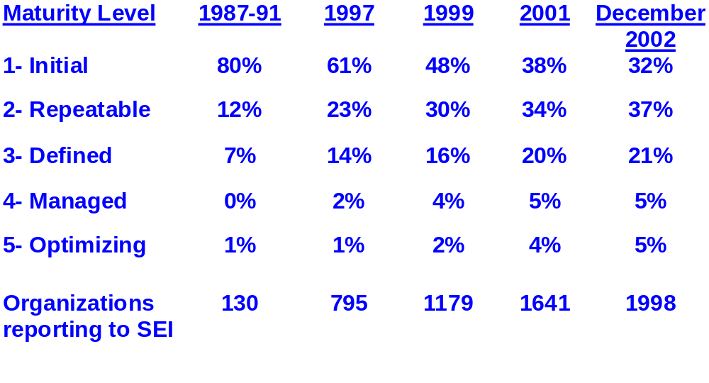
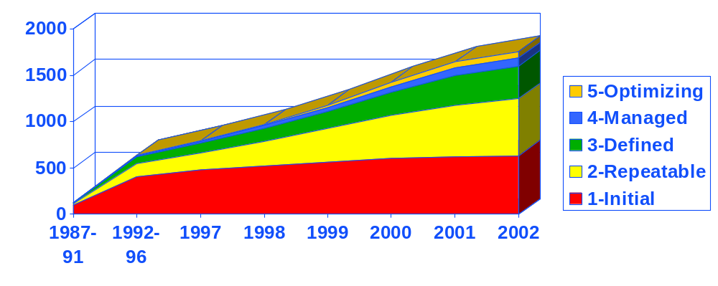
CMM Process Maturity Profile of Software Community
Source: http://www.sei.cmu.edu/sema/profile.html
Notes:
Source - SEI SEMA(The Software Engineering Measurement and Analysis Initiative at the SEI) – reported voluntarily.

Slide 22
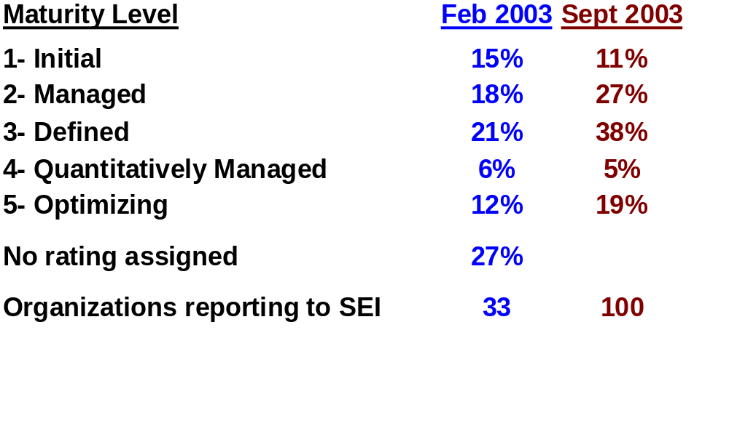
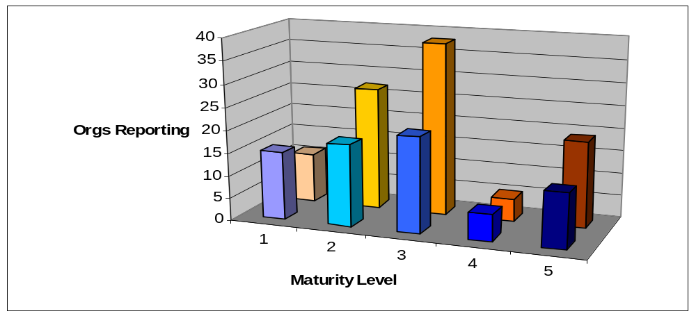
CMMI Process Maturity Profile
C M M I
Source: http://www.sei.cmu.edu/sema/profile.html
Notes:
Source - SEI SEMA(The Software Engineering Measurement and Analysis Initiative at the SEI)

Slide 23
CMM and CMMI Advocates
Know Thy Competition: Organizations at CMM or CMMI Level 4 or 5
Boeing CSC Defense Group Honeywell
Hughes Litton Lockheed Martin
Motorola NCR Northrop Grumman
Raytheon United Space Alliance USAF Hill AFB
USAF Tinker AFB USA CECOM USN FMSO
NAWC China Lake NSWC PHD (Dam Neck) SAIC
BAE Rancho Bernardo IBM NASA Shuttle
USA Fort Sill
SW-CMM sources:
  CMM Softcopy: http://www.sei.cmu.edu/cmm/obtain.cmm.html
  Overview article: in SME Guidebook and at
  http://www.sei.cmu.edu/publications/documents/96.reports/96.ar.cmm.v1.1.html
  Power Point Overview: http://sepo.spawar.navy.mil/sepo/CMM_Overview.PPT
  Expert Mode: http://sepo.spawar.navy.mil/sepo/CMMExpert10.doc
  KPA Flow diagrams: http://sepo.spawar.navy.mil/sepo/CMMinfo.html
CMMI Sources:
  CMMI Softcopy: http://www.sei.cmu.edu/cmmi/models/models.html
  Transitioning to CMMI – A Guide for Executives http://www.sei.cmu.edu/cmmi/publications/exec.pdf
Notes:
Animation: company names zap in automatically
Data at http://seir.sei.cmu.edu/pml/index.asp
On SEMA web calculations (July 2003)
88 orgs. now at Level 4
116 now at Level 5
The CMM has been selected by the DoD and SSC to provide measures of maturity; but more importantly the guidelines and best practices to achieve project (org?) success.
Case for BP topic validated CMM use at Boeing, Motorola, China Lake, MATCALS
SAIC has 23 orgs at CMM L3 or higher. Goal of CMMI L3 “late 2003”.

Slide 24
The CMM and CMMI: Summary
You should now know:
Who developed the CMM and CMMI?
Which model(s) is/are SSC San Diego using?
What is the focus of Maturity Level 2?
What is the focus of Maturity Level 3?
How are Maturity Levels determined?
How is SSC San Diego’s maturity compared to other organizations?
Σ
Notes:
Optional exercise: can pass by this or assign questions to student tables to look up answers:
DoD-sponsored Software Engineering Institute
SW-CMM sand CMMI-SE/SW/IPPD
Basic Project management
Organizational process standardization
SCE or SCAMPI
Level 3 is in upper 30% of CMM organizations, but behind lots of competitors

